Slide 1
API’s INTRO
Miguel Betin-Montes

Slide 2
What is an API?
An API is a set of programming code that enables data transmission.
APIs allow one software service to access data from another software service without the developer's needing to know how the other service works.
The interface by which these two applications communicate is what the API specifies.
APIs are sometimes considered contracts, where documentation is an agreement between the parties:
“If party first sends a remote request structured a particular way, this is how
the second party’s software will respond.”

Slide 3
Although APIs can work with any common programming language, the most popular approach to delivering web APIs is REST (REpresentational State Transfer). A RESTful API architecture uses HTTP coding for much of its functionality.

Slide 4
How an API works
A client application initiates an API call to retrieve information—also known as a request. This request is processed from an application to the web server via the API’s Uniform Resource Identifier (URI) and includes a request verb, headers, and sometimes, a request body.
After receiving a valid request, the API makes a call to the external program or web server.
The server sends a response to the API with the requested information.
The API transfers the data to the initial requesting application.

Slide 5
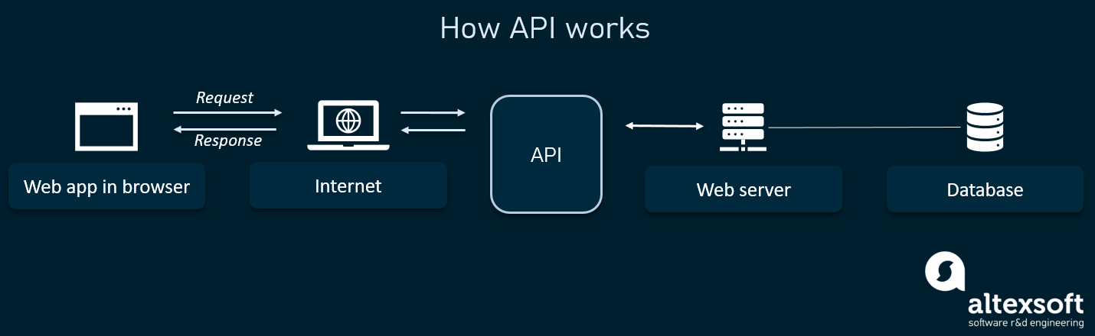

Slide 6
Types of APIs
In terms of release policies, APIs can be private, partner, and public.
Private APIs. These application software interfaces are designed for improving solutions and services within an organization. In-house developers or contractors may use these APIs to integrate a company’s IT systems or applications, build new systems or customer-facing apps leveraging existing systems.
The private strategy allows a company to fully control the API usage.

Slide 7
Partner APIs. Partner APIs are openly promoted but shared with business partners who have signed an agreement with the publisher. The common use case for partner APIs is software integration between two parties. A company that grants partners with access to data or capability benefits from extra revenue streams.
Public APIs. These APIs are available for any third-party developers. API description and any related documentation must be openly available, and that the API can be freely used to create and test applications.

Slide 8
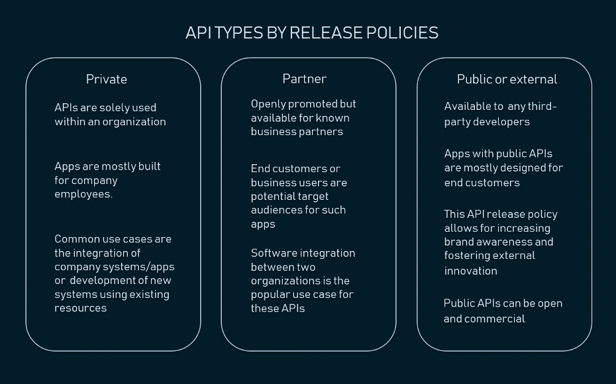

Slide 9
APIs by use cases
Database APIs.
Operating systems APIs.
Remote APIs.
Web APIs.

Slide 10
Types of API protocols
SOAP (Simple Object Access Protocol) is an API protocol built with XML, enabling users to send and receive data through SMTP and HTTP.
XML-RPC is a protocol that relies on a specific format of XML to transfer data, whereas SOAP uses a proprietary XML format.
JSON-RPC is a protocol similar to XML-RPC, as they are both remote procedure calls (RPCs), but this one uses JSON instead of XML format to transfer data. Both protocols are simple. While calls may contain multiple parameters, they only expect one result.
REST (Representational State Transfer) is a set of web API architecture principles, which means there are no official standards (unlike those with a protocol). To be a REST API (also known as a RESTful API), the interface must adhere to certain architectural constraints. It’s possible to build RESTful APIs with SOAP protocols, but the two standards are usually viewed as competing specifications.

Slide 11
Representational State Transfer (REST)
The term REST was introduced by computer scientist Roy Fielding in a dissertation in 2000. Unlike SOAP, which is a protocol, REST is a software architectural style with six constraints for building applications that work over HTTP, often web services.
REST is considered a simpler alternative to SOAP, which many developers find difficult to use because it requires writing a lot of code to complete every task and following the XML structure for every message sent.
REST follows another logic since it makes data available as resources. Each resource is represented by a unique URL, and one can request this resource by providing its URL.
http://myserver/api/resource
http://myserver/api/resource/resourceId

Slide 12
Web APIs that comply with REST architectural constraints are called RESTful APIs. These APIs use HTTP requests (AKA methods or verbs) to work with resources: POST, GET, PUT, PATCH, DELETE.
These correspond to create, read, update, and delete operations, respectively. There are a number of other verbs, too, but are utilized less frequently. Of those less-frequent methods, OPTIONS and HEAD are used more often than others.
RESTful systems support messaging in different formats, such as plain text, HTML, YAML, XML, and JSON, while SOAP only allows XML.
The ability to support multiple formats for storing and exchanging data is one of the reasons REST is a prevailing choice for building public APIs these days.

Slide 13
JSON
JavaScript Object Notation (JSON) is a lightweight and easy-to-parse text format for data exchange. Its syntax is based on a subset of the Standard ECMA-262 3rd Edition. Each JSON file contains collections of name/value pairs and ordered lists of values. Since these are universal data structures, the format can be used with any programming language.
{
"companyName": "Mobil",
"yearFounded": 1911,
"owner": “ExxonMobil”
}
XML:
<company>
<companyName>”Mobil”</companyName>
<yearFounded>1911</yearFounded>
<owner>”ExxonMobil”</owner>
</company>

Slide 14
HTTP Status Codes
Status codes are issued by a server in response to a client's request made to the server.
The first digit of the status code specifies one of five standard classes of responses. The message phrases shown are typical, but any human-readable alternative may be provided.
The Internet Assigned Numbers Authority (IANA) maintains the official registry of HTTP status codes.^{[2]}
All HTTP response status codes are separated into five classes or categories. The first digit of the status code defines the class of response, while the last two digits do not have any classifying or categorization role. There are five classes defined by the standard:
1xx informational response – the request was received, continuing process
2xx successful – the request was successfully received, understood, and accepted
3xx redirection – further action needs to be taken in order to complete the request
4xx client error – the request contains bad syntax or cannot be fulfilled
5xx server error – the server failed to fulfil an apparently valid request

Slide 15
200 - OK
201 - Created
204 - No Content
400 - Bad Request
401 - Unauthorized
403 - Forbidden
404 - Not Found
405 - Method Not Allowed
500 - Internal Server Error
503 - Service Unavailable

Slide 16
Common API examples
Universal logins: A popular API example is the function that enables people to login to websites by using their Facebook, Twitter, or Google profile login details.
Third-party payment processing: For example, the "Pay with PayPal" function you see on ecommerce websites works through an API. This allows people to pay for products online without exposing any sensitive data or granting access to unauthorized individuals.
Travel booking comparisons: Travel booking sites aggregate thousands of flights, showcasing the cheapest options for every date and destination. This service is made possible through APIs that provide application users with access to the latest information about availability from hotels and airlines. With an autonomous exchange of data and requests, APIs dramatically reduce the time and effort involved in checking for available flights or accommodation.
Google Maps: One of the most common examples of a good API is the Google Maps service. In addition to the core APIs that display static or interactive maps, the app utilizes other APIs and features to provide users with directions or points of interest. Through geolocation and multiple data layers, you can communicate with the Maps API when plotting travel routes or tracking items on the move, such as a delivery vehicle.
Twitter: Each Tweet contains descriptive core attributes, including an author, a unique ID, a message, a timestamp when it was posted, and geolocation metadata. Twitter makes public Tweets and replies available to developers and allows developers to post Tweets via the company's API.

Slide 17
GraphQL
The need for faster feature development, more efficient data loading due to increased mobile adoption, and a multitude of clients, made the developers look for other approaches to software architecture. GraphQL, initially created by Facebook in 2012 for internal use, is the new REST with organizations like Shopify, Yelp, GitHub, Coursera, and The New York Times using it to build APIs.
GraphQL is a query language for APIs. It allows the client to detail the exact data it needs and simplifies data aggregation from multiple sources, so the developer can use one API call to request all needed data. Another special feature of GraphQL is that it uses a type system to describe data.

